Slide 1

Automated Attendance Tracking via Face Recognition

Slide 2
Automated Attendance Tracking via Face Recognition

Slide 3
Agenda
Introduction
Introduction
Project Objectives
Problem Statement
Literature Review
Tools Used
Technologies Used
System Architecture
Core Features
Data Pipeline
Machine Learning Model
Conclusion
Demo Video
Future Work
Automated Attendance Tracking: System replaces manual processes with real-time face recognition
Dual-Mode Operation: Supports both attendance marking (check-in) and leave recording (check-out)

Slide 4

Agenda
Introduction
Introduction
Project Objectives
Problem Statement
Literature Review
Tools Used
Technologies Used
System Architecture
Core Features
Dataset & Pre-Processing
Machine Learning Model
Conclusion
Automated Attendance Tracking: System replaces manual processes with real-time face recognition
Dual-Mode Operation: Supports both attendance marking (check-in) and leave recording (check-out)
Project Objectives
Develop real-time face detection/recognition system.
Automate attendance logging with Excel backend.
Implement admin dashboard for attendance analytics.
Prevent proxy attendance through biometric verification.
Optimize performance for low-resource environments.

Slide 5


Introduction
Automated Attendance Tracking: System replaces manual processes with real-time face recognition
Dual-Mode Operation: Supports both attendance marking (check-in) and leave recording (check-out)
Agenda
Project Objectives
Problem Statement
Introduction
Project Objectives
Problem Statement
Literature Review
Tools Used
Technologies Used
System Architecture
Core Features
Dataset & Pre-Processing
Machine Learning Model
Conclusion
Develop real-time face detection/recognition system.
Automate attendance logging with Excel backend.
Implement admin dashboard for attendance analytics.
Prevent proxy attendance through biometric verification.
Optimize performance for low-resource environments.
Manual attendance is time-consuming (avg. 15 min/day for 50 people).
Traditional systems have 12-15% error rate (ID swaps, buddy punching).
Contact-based systems pose hygiene concerns (post-pandemic).
No real-time visibility into attendance metrics.

Slide 6



Technology | Application in Project | Key Paper/Resource
HOG Algorithm | Face Detection in CPU Mode | Dalal & Triggs (2005)
CNN Models | GPU-Accelerated Face Recognition | ResNet (2015)
Face Embeddings | 128-D Encodings for Identification | FaceNet (Schroff)
Flask Framework | Web Interface and API Handling | Flask Official Documentation
Project Objectives
Problem Statement
Develop real-time face detection/recognition system.
Automate attendance logging with Excel backend.
Implement admin dashboard for attendance analytics.
Prevent proxy attendance through biometric verification.
Optimize performance for low-resource environments.
Manual attendance is time-consuming (avg. 15 min/day for 50 people).
Traditional systems have 12-15% error rate (ID swaps, buddy punching).
Contact-based systems pose hygiene concerns (post-pandemic).
No real-time visibility into attendance metrics.

Slide 7

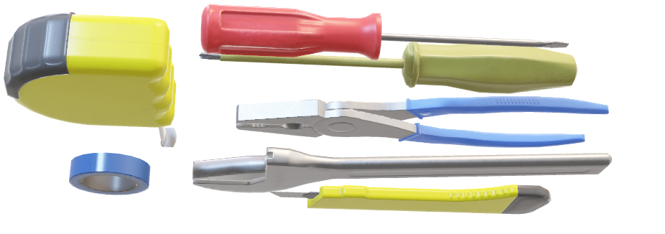
Project Objectives
Literature Review
Problem Statement
Develop real-time face detection/recognition system.
Automate attendance logging with Excel backend.
Implement admin dashboard for attendance analytics.
Prevent proxy attendance through biometric verification.
Optimize performance for low-resource environments.
Technology | Application in Project | Key Paper/Resource
HOG Algorithm | Face Detection in CPU Mode | Dalal & Triggs (2005)
CNN Models | GPU-Accelerated Face Recognition | ResNet (2015)
Face Embeddings | 128-D Encodings for Identification | FaceNet (Schroff)
Flask Framework | Web Interface and API Handling | Flask Official Documentation
Manual attendance is time-consuming (avg. 15 min/day for 50 people).
Traditional systems have 12-15% error rate (ID swaps, buddy punching).
Contact-based systems pose hygiene concerns (post-pandemic).
No real-time visibility into attendance metrics.
Tools Used
Development: VS Code, Jupyter Notebook.
Version Control: Git/GitHub.
Testing: Browser DevTools.
Documentation: Word, PowerPoint.
Packaging: Pipenv, requirements.txt.

Slide 8
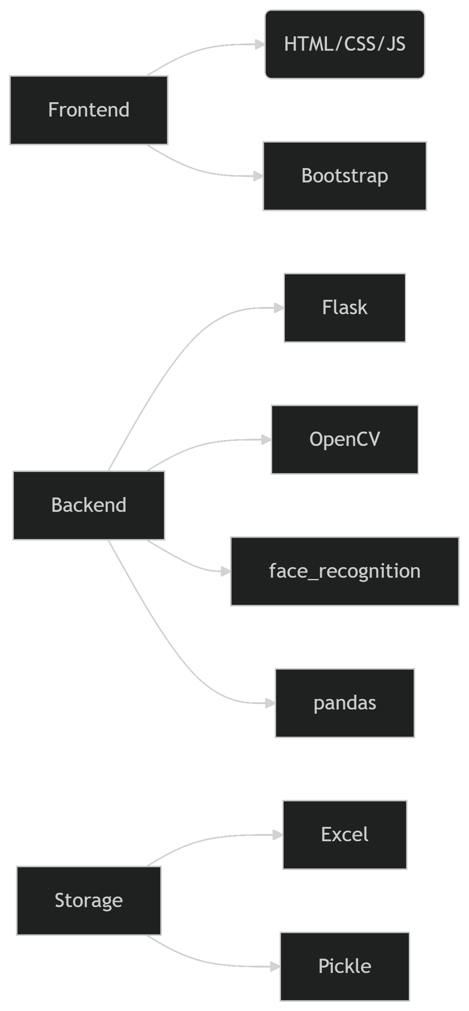
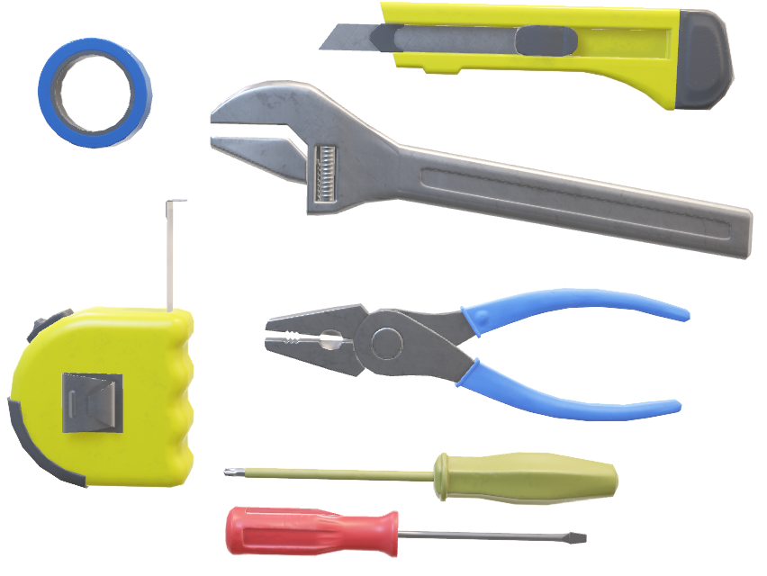
Technologies Used
Tools Used
Development: VS Code, Jupyter Notebook.
Version Control: Git/GitHub.
Testing: Browser DevTools.
Documentation: Word, PowerPoint.
Packaging: Pipenv, requirements.txt.
Literature Review
Technology | Application in Project | Key Paper/Resource
HOG Algorithm | Face Detection in CPU Mode | Dalal & Triggs (2005)
CNN Models | GPU-Accelerated Face Recognition | ResNet (2015)
Face Embeddings | 128-D Encodings for Identification | FaceNet (Schroff)
Flask Framework | Web Interface and API Handling | Flask Official Documentation

Slide 9
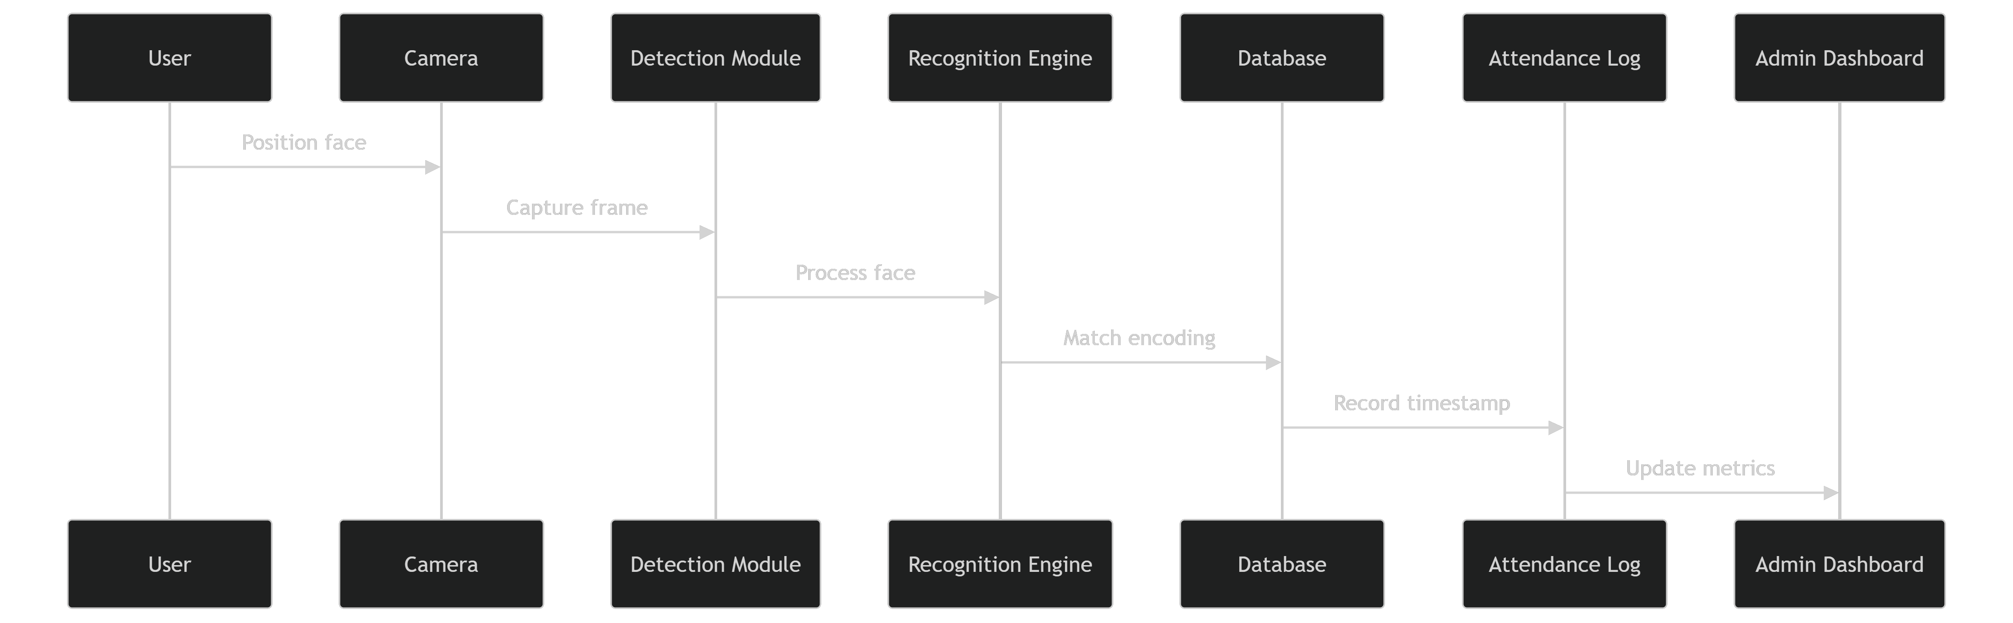
Tools Used
Development: VS Code, Jupyter Notebook.
Version Control: Git/GitHub.
Testing: Browser DevTools.
Documentation: Word, PowerPoint.
Packaging: Pipenv, requirements.txt.
System Architecture
Technologies Used

Slide 10
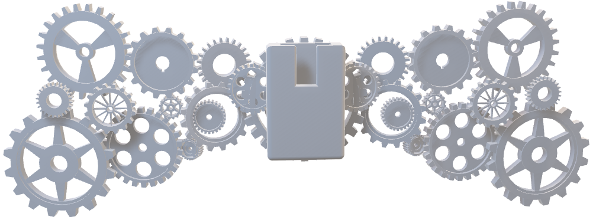
System Architecture
Technologies Used
Core Features
Dual Operations Modes:
Attendance Mode (Check-In)
Leave Mode (Check-Out)
Admin Functions:
Employee Registration with Photo Capture
Delete Employee Records
Attendance Analytics
Optimization Features:
Frame Skipping
Dynamic Resolution Scaling
Face Encoding Caching
Batch Processing

Slide 11
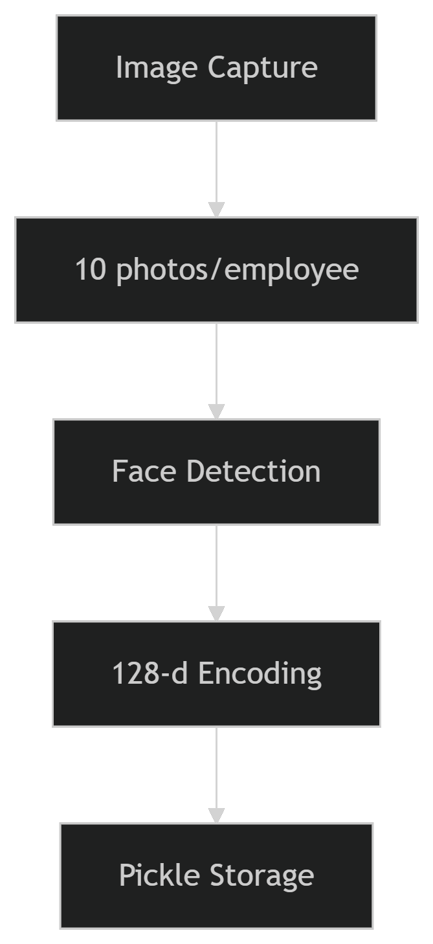
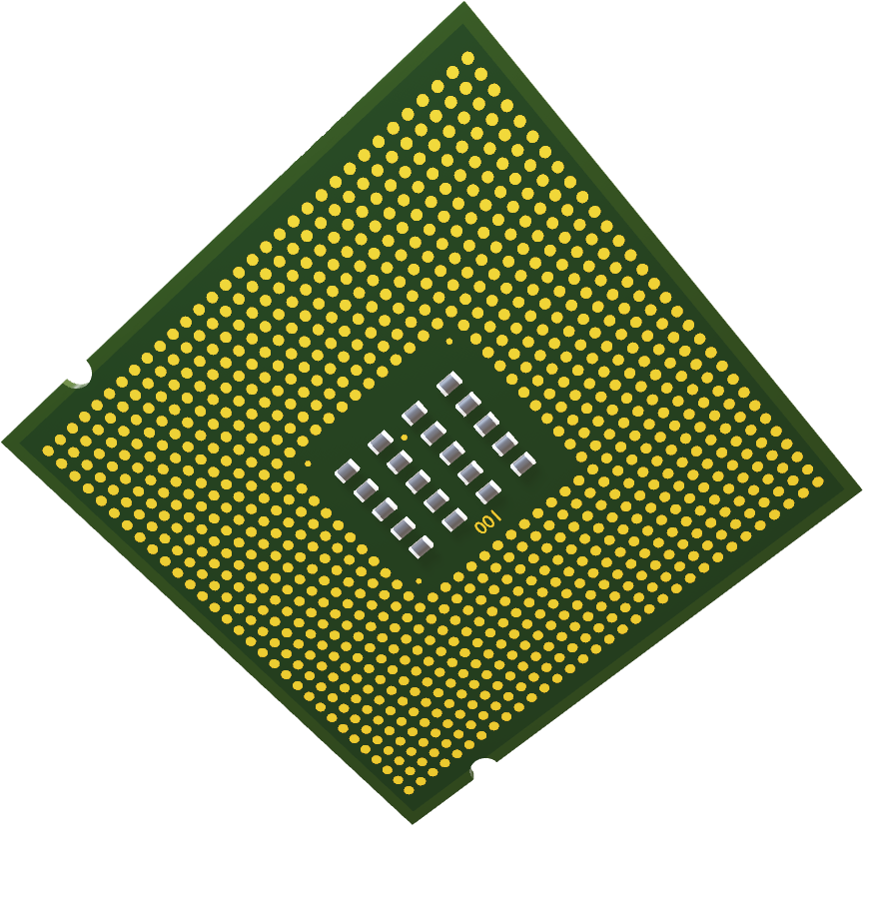
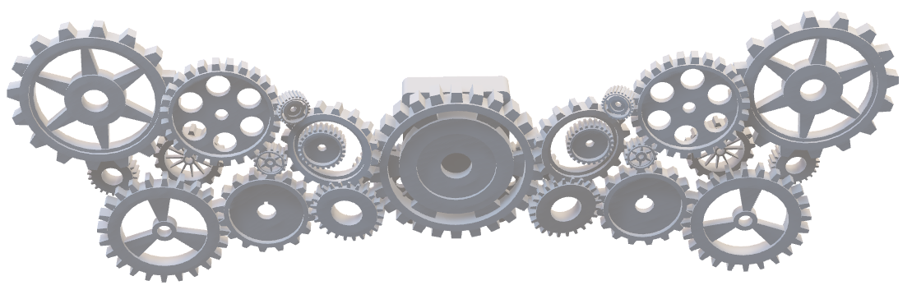
Data Pipeline:
Core Features
Dual Operations Modes:
Attendance Mode (Check-In)
Leave Mode (Check-Out)
Admin Functions:
Employee Registration with Photo Capture
Delete Employee Records
Attendance Analytics
Optimization Features:
Frame Skipping
Dynamic Resolution Scaling
Face Encoding Caching
Batch Processing
System Architecture

Slide 12
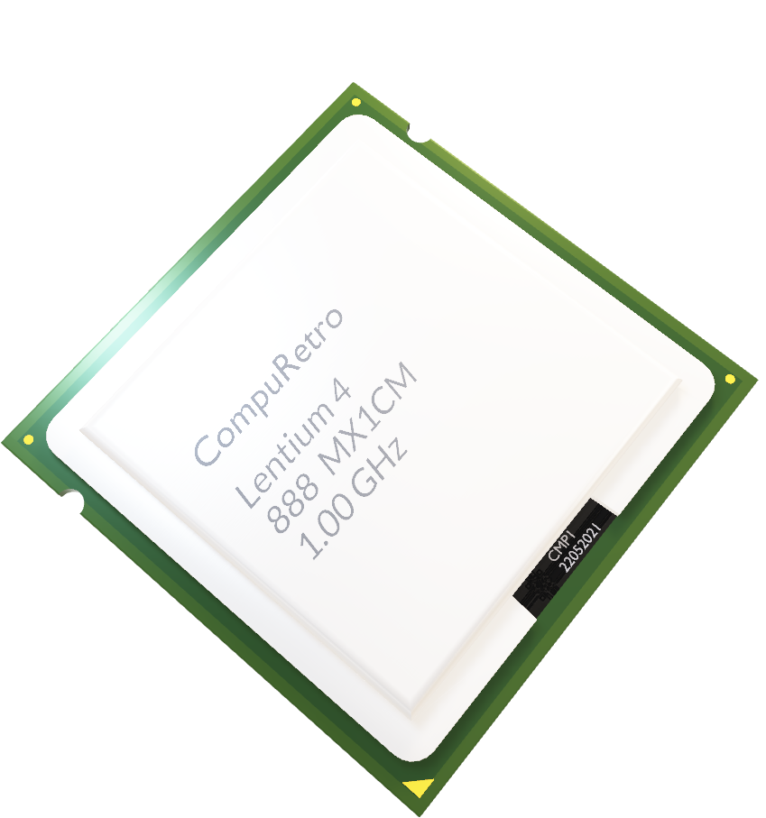
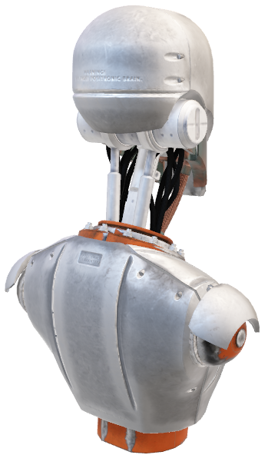
Machine Learning
Data Pipeline:
Face Recognition Workflow:
Input: Video frame (720p/1080p).
Detection: HOG/CNN face localization.
Encoding: 128-d embedding generation.
Matching: Cosine similarity comparison.
Threshold: 0.6 tolerance (40% stricter than default).
Performance Metrics:
Accuracy: 92.4% (tested on 50 employees).
Processing Speed: 8-12 FPS (CPU mode).
False Acceptance Rate: 3.1%
Core Features
Dual Operations Modes:
Attendance Mode (Check-In)
Leave Mode (Check-Out)
Admin Functions:
Employee Registration with Photo Capture
Department Based Filtering
Delete Employee Records
Attendance Analytics
Optimization Features:
Frame Skipping
Dynamic Resolution Scaling
Face Encoding Caching
Batch Processing

Slide 13
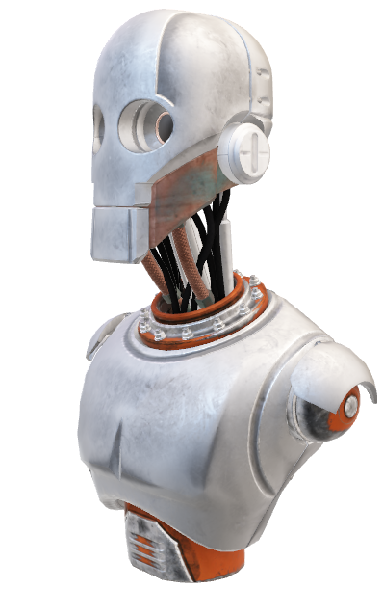
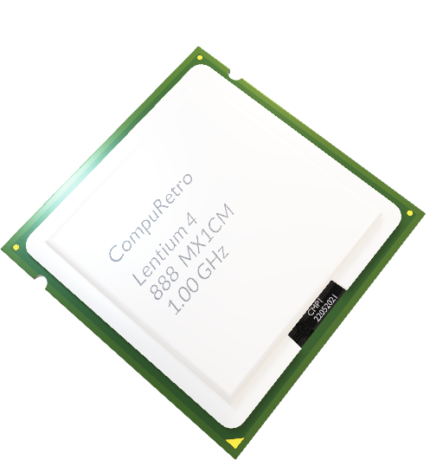

Machine Learning
Conclusion
Face Recognition Workflow:
Input: Video frame (720p/1080p).
Detection: HOG/CNN face localization.
Encoding: 128-d embedding generation.
Matching: Cosine similarity comparison.
Threshold: 0.6 tolerance (40% stricter than default).
Achievements:
87% Reduction in Attendance Time
Eliminated Proxy Attendance Cases
Department-Level Analytics Implementation
CPU-Optimized for Low-Resource Settings
Future Enhancements:
Live Video Streaming to Cloud
Mask Detection Module
Blockchain-Based Record Keeping
Project Impact:
Deployable in Schools/Offices with Basic Hardware
Open-Source Alternative to Commercial Systems
Scalable Architecture for 500+ Users
Performance Metrics:
Accuracy: 92.4% (tested on 50 employees).
Processing Speed: 8-12 FPS (CPU mode).
False Acceptance Rate: 3.1%
Dataset & Pre-Processing
Data Pipeline:
Pre-Processing Techniques:
RGB Conversion
Resolution Scaling
Face Alignment via Landmark Detection
Histogram Equalization

Slide 14
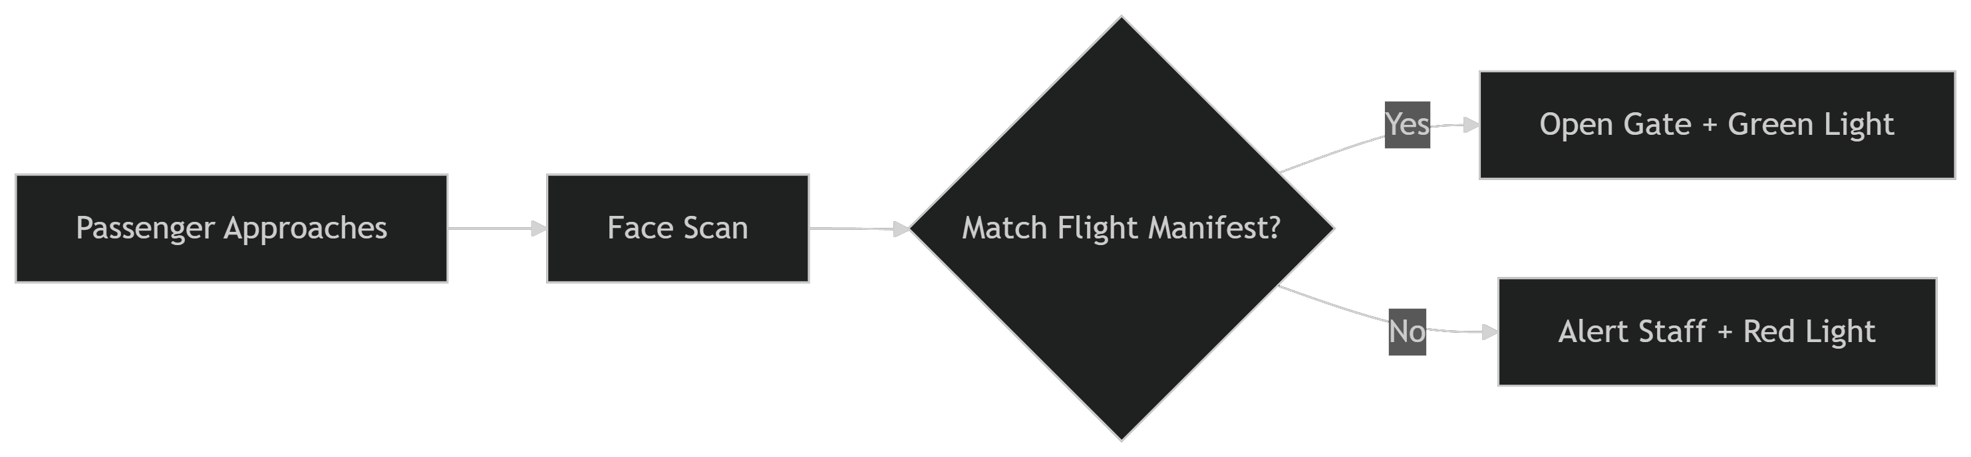


Conclusion
Achievements:
87% Reduction in Attendance Time
Eliminated Proxy Attendance Cases
Department-Level Analytics Implementation
CPU-Optimized for Low-Resource Settings
Future Enhancements:
Live Video Streaming to Cloud
Mask Detection Module
Blockchain-Based Record Keeping
Project Impact:
Deployable in Schools/Offices with Basic Hardware
Open-Source Alternative to Commercial Systems
Scalable Architecture for 500+ Users
Machine Learning
Face Recognition Workflow:
Input: Video frame (720p/1080p).
Detection: HOG/CNN face localization.
Encoding: 128-d embedding generation.
Matching: Cosine similarity comparison.
Threshold: 0.6 tolerance (40% stricter than default).
Future Work
Vision: Extend face recognition technology to streamline passenger processing at airports, reducing boarding times by 65% and enhancing security.
Performance Metrics:
Accuracy: 92.4% (tested on 50 employees).
Processing Speed: 8-12 FPS (CPU mode).
False Acceptance Rate: 3.1%
Key Implementation Area:
Automated Check-In:
Facial Recognition Replaces Boarding Passes
Baggage Tagging linked to Biometric Profile
Smart Boarding Gates:
VIP/Assistance Identification:
Automatic Detection of Premium Passangers
Special Needs Traveler Alerts to Staff
Unaccompanied Minor Tracking

Slide 15

THANK YOU!
Future Work
Conclusion
Vision: Extend face recognition technology to streamline passenger processing at airports, reducing boarding times by 65% and enhancing security.
Achievements:
87% Reduction in Attendance Time
Eliminated Proxy Attendance Cases
Department-Level Analytics Implementation
CPU-Optimized for Low-Resource Settings
Future Enhancements:
Live Video Streaming to Cloud
Mask Detection Module
Blockchain-Based Record Keeping
Project Impact:
Deployable in Schools/Offices with Basic Hardware
Open-Source Alternative to Commercial Systems
Scalable Architecture for 500+ Users
Key Implementation Area:
Automated Check-In:
Facial Recognition Replaces Boarding Passes
Baggage Tagging linked to Biometric Profile
Smart Boarding Gates:
Machine Learning
VIP/Assistance Identification:
Automatic Detection of Premium Passangers
Special Needs Traveler Alerts to Staff
Unaccompanied Minor Tracking
Face Recognition Workflow:
Input: Video frame (720p/1080p).
Detection: HOG/CNN face localization.
Encoding: 128-d embedding generation.
Matching: Cosine similarity comparison.
Threshold: 0.6 tolerance (40% stricter than default).
Performance Metrics:
Accuracy: 92.4% (tested on 50 employees).
Processing Speed: 8-12 FPS (CPU mode).
False Acceptance Rate: 3.1%

Slide 16
Future Work
Conclusion
Vision: Extend face recognition technology to streamline passenger processing at airports, reducing boarding times by 65% and enhancing security.
Achievements:
87% Reduction in Attendance Time
Eliminated Proxy Attendance Cases
Department-Level Analytics Implementation
CPU-Optimized for Low-Resource Settings
Future Enhancements:
Live Video Streaming to Cloud
Mask Detection Module
Blockchain-Based Record Keeping
Project Impact:
Deployable in Schools/Offices with Basic Hardware
Open-Source Alternative to Commercial Systems
Scalable Architecture for 500+ Users
Key Implementation Area:
Automated Check-In:
Facial Recognition Replaces Boarding Passes
Baggage Tagging linked to Biometric Profile
THANK YOU!
Smart Boarding Gates:
VIP/Assistance Identification:
Automatic Detection of Premium Passangers
Special Needs Traveler Alerts to Staff
Unaccompanied Minor Tracking
Face Recognition Workflow:
Input: Video frame (720p/1080p).
Detection: HOG/CNN face localization.
Encoding: 128-d embedding generation.
Matching: Cosine similarity comparison.
Threshold: 0.6 tolerance (40% stricter than default).
Performance Metrics:
Accuracy: 92.4% (tested on 50 employees).
Processing Speed: 8-12 FPS (CPU mode).
False Acceptance Rate: 3.1%

